Slide 1
OBJECT DETECTION WITH MACHINE LEARNING
SUBMITTED BY
AMNA NOREEN
FATIMA JAVED
SAMAN
HAFIZA FIZA KHAN

Slide 2
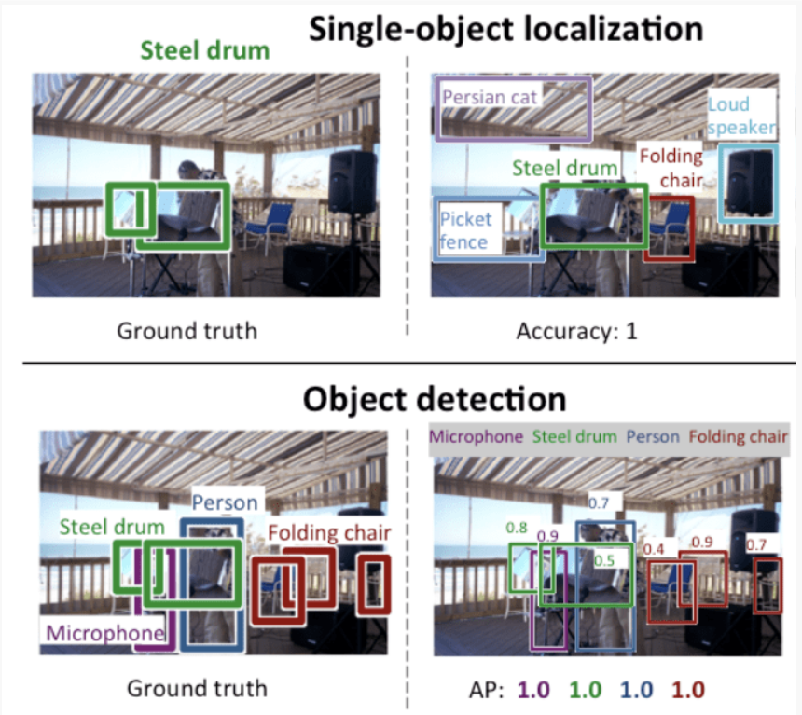
1. INTRODUCTION TO OBJECT DETECTION
Object Detection is a common Computer Vision problem which deals with identifying and locating object of certain classes in the image or video.

Slide 3
LITERATURE REVIEW:
Object detection is a common term for computer vision techniques classifying and locating objects in an image. Modern object detection is largely based on use of convolutional neural networks Some of the most relevant system types today are Faster R-CNN, R-FCN, Multibox Single Shot Detector (SSD) and YOLO (You Only Look Once) . Original R-CNN method worked by running a neural net classifier on samples cropped from images using externally computed box proposals (=samples cropped with externally computed box proposals; feature extraction done on all the cropped samples). This approach was computationally expensive due to many crops.
Single Shot Multibox Detector (SSD) differs from the R-CNN based approaches by not requiring a second stage per-proposal classification operation. This makes it fast enough for real-time detection applications. However, this comes with a price of reduced precision . “SSD with MobileNet” refers to a model where model meta architecture is SSD and the feature extractor type is MobileNet.

Slide 4
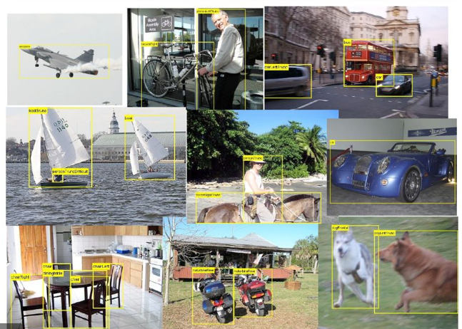
2. GENERIC OBJECT DETECTION
Aiming at locating object instances from a large number of predefined categories in natural images.

Slide 5
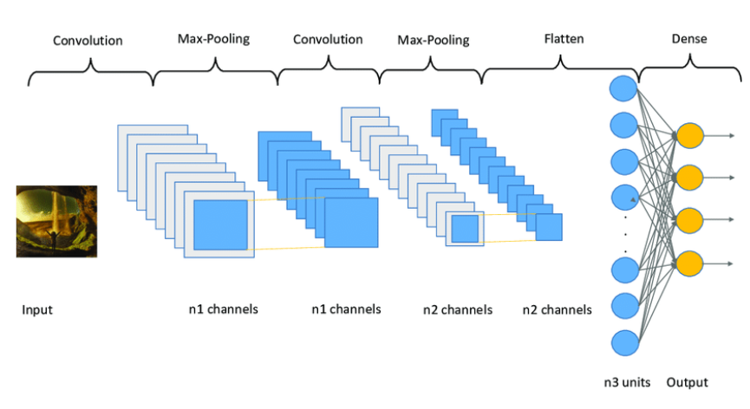
3. ARCHITECTURE OF CNN
Convolutional Neural Network (CNN) is a Deep Learning algorithm that can take in an input image, assign importance to different aspects/objects in the image, and distinguish one from the other.

Slide 6
4. BUILDING THE CNN
CONVOLUTION
POOLING
FLATTENING

Slide 7
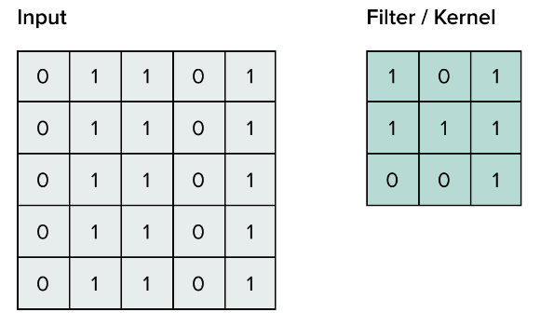
CONVOLUTION
Convolution preserves the spatial relationship between pixels by learning image features using small squares of input data.

Slide 8
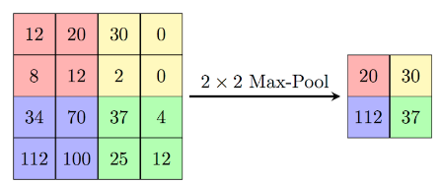
POOLING
The process of extracting the features from the image output of a convolution layer.

Slide 9
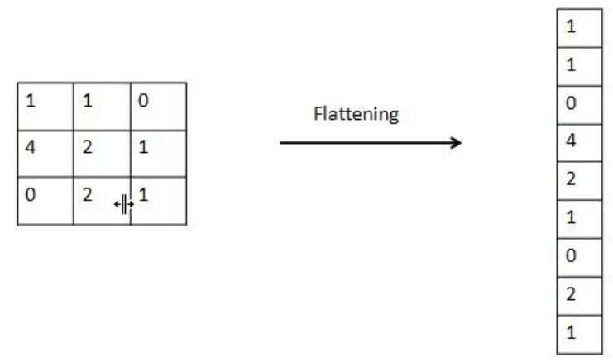
FLATTENING
Flattening is converting the data into a 1-dimensional array for inputting it to the next layer.

Slide 10
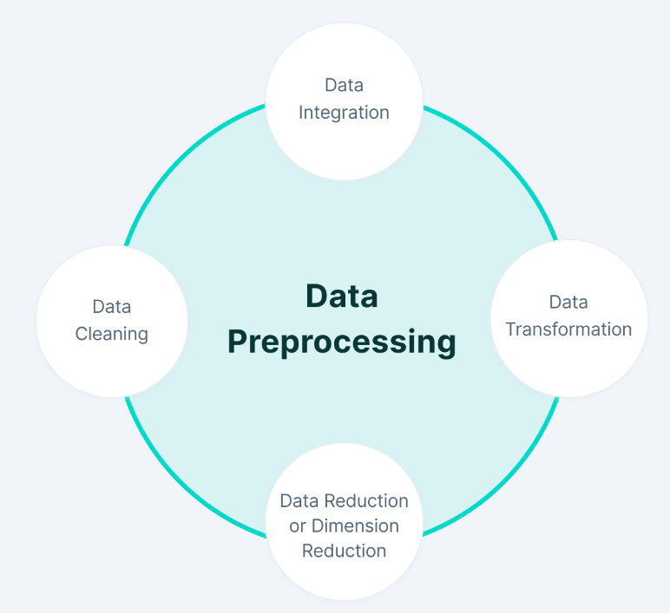
5. DATASET & PREPROCESSING
Data preprocessing in Machine Learning refers to the technique of preparing (cleaning and organizing) the raw data to make it suitable for a building and training Machine Learning models.

Slide 11
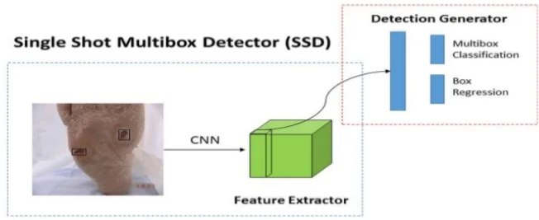
6. WHAT IS SSD?
SSD is a single-stage object detection method that discretizes the output space of bounding boxes into a set of default boxes over different aspect ratios and scales per feature map location.

Slide 12
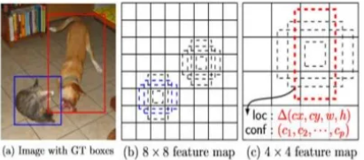
7. SSD FRAMEWORK
Multi-scale feature maps for detection.
Convolutional predictors for detection.
Default boxes and aspect ratios.

Slide 13
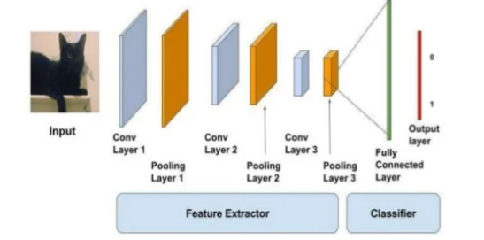
8. FEATURE EXTRACTION
An object is represented by a group of features in form of a feature vector. This feature vector is used to recognize objects and classify them.

Slide 14
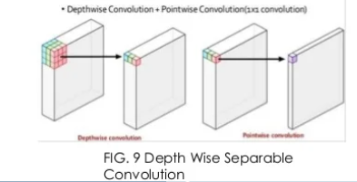
9. CLASSIFICATION & LOCALIZATION
Classify each region using MobileNet V1 Architecture for each category by passing feature vector created from feature extraction and scored region are then adjusted with bounding box regression.
This architecture uses depth wise separable convolutions which significantly reduces the number of parameters when compared to the network with normal convolutions.

Slide 15
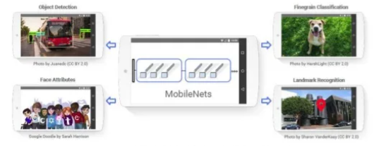
MOBILENET V1 ARCHITECTURE
It uses Separable Convolution to reduce the model size and complexity.
Smaller model size: Fewer number of parameters.
Smaller complexity: Fewer Multiplications and Additions (Multi-Adds)

Slide 16
ADVANTAGES OF MOBILENET V1 ARCHITECTURE
The main advantages is their accuracy in image recognition problem.
It takes less time.
Improve the quality of candidate bounding boxes.

Slide 17
TOOLS & LIBRARIES
Anaconda — Anaconda is a free and open source distribution of the Python and R programming languages for data science and machine learning related applications.
Spyder — Spyder is an open source cross-platform IDE for scientific programming in the Python language.
Matplotlib- Matplotlib is a Python 2D plotting library which produces publication quality figures in a variety of hardcopy formats and interactive environments across platforms.
CV2- cv2 is the module import name for opencv-python, "Unofficial pre-built CPU-only OpenCV packages for Python“.

Slide 18
DRY RUN
import cv2
import matplotlib.pyplot as plt
config_file= 'F:/Saman/ssd_mobilenet_v3_large_coco_2020_01_14.pbtxt'
frozen_model= 'F:/Saman/frozen_inference_graph.pb'
model=cv2.dnn_DetectionModel(frozen_model,config_file)
classLabels=[]
file_name='F:/Saman/Labels.txt'
with open(file_name,'rt') as fpt:
classLabels=fpt.read().rstrip('\n').split('\n')
print(classLabels)
print(len(classLabels))
model.setInputSize(320,320)
model.setInputScale(1.0/127.5)
model.setInputMean((127.5,127.5,127.5))
model.setInputSwapRB(True)

Slide 19
#read an image
img=cv2.imread('F:/Saman/ik.jpg')
plt.imshow(img)
plt.imshow(cv2.cvtColor(img,cv2.COLOR_BGR2RGB))
ClassIndex, confidence, bbox=model.detect(img,confThreshold=0.5)
print(ClassIndex)
font_scale=3
font=cv2.FONT_HERSHEY_PLAIN
for ClassInd, conf, boxes in zip(ClassIndex.flatten(), confidence.flatten(), bbox):
#cv2.rectangle(frame, (x, y), (x+w, y+h), (255, 0, 0), 2)
#cv2.putText(img, text, (text_offset_x, text_offset_y), font, fontScale=font_scale, color=(0, 0, 0), thickness=1)
cv2.rectangle(img,boxes,(255, 0, 0), 2)
cv2.putText(img,classLabels[ClassInd-1],(boxes[0]+10,boxes[1]+40), font, fontScale=font_scale,color=(0, 255, 0), thickness=3)
plt.imshow(cv2.cvtColor(img, cv2.COLOR_BGR2RGB))

Slide 20
#for video
cap=cv2.VideoCapture("F:/Saman/bicycle.mp4")
if not cap.isOpened():
cap=cv2.VideoCapture(0)
if not cap.isOpened():
raise IOError("Cannot open Video")
font_scale=3
font=cv2.FONT_HERSHEY_PLAIN
while True:
ret,frame = cap.read()
ClassIndex, confidence, bbox=model.detect(frame,confThreshold=0.55)
print(ClassIndex)
if(len(ClassIndex)!=0):
for ClassInd, conf, boxes in zip(ClassIndex.flatten(),confidence.flatten(), bbox):
if(ClassInd <= 80):
cv2.rectangle(frame,boxes,(255,0,0),2)
cv2.putText(frame,classLabels[ClassInd - 1],(boxes[0]+10,boxes[1]+40),font,fontScale=font_scale,color=(0,255,0),thickness=3)
cv2.imshow('Object Detection Tutorial', frame)
if cv2.waitKey(2) & OxFF == ord('q'):
break
cap.release()
cv2.destroyAllwindows()

Slide 21
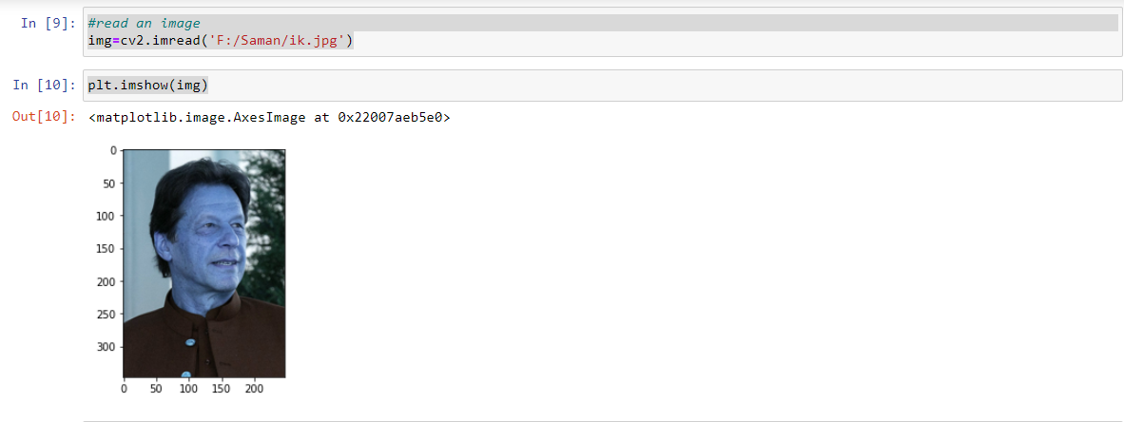
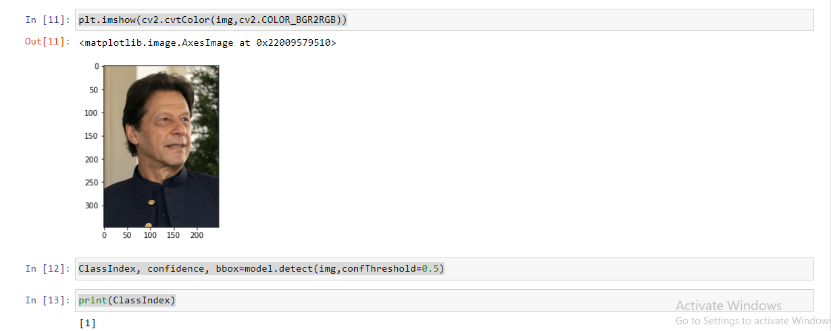

Slide 22
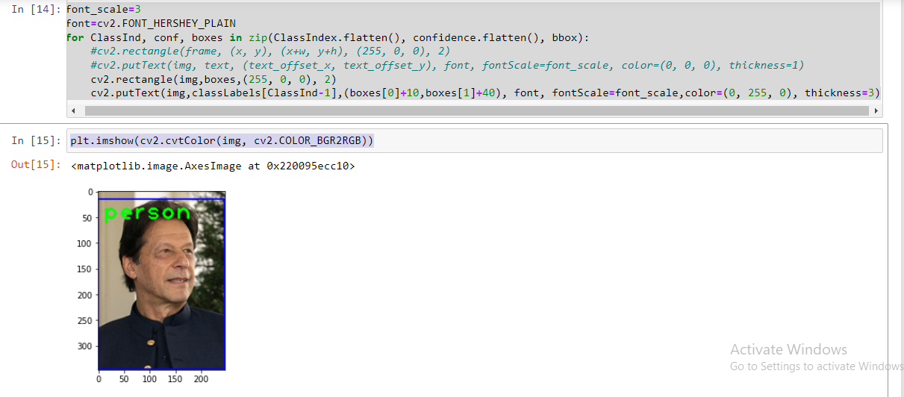

Slide 23
YOUTUBE VIDEO LINK
https://www.youtube.com/watch?v=pDhTv83_wfI&feature=youtu.be

Slide 24
THANK YOU.

